Slide 1
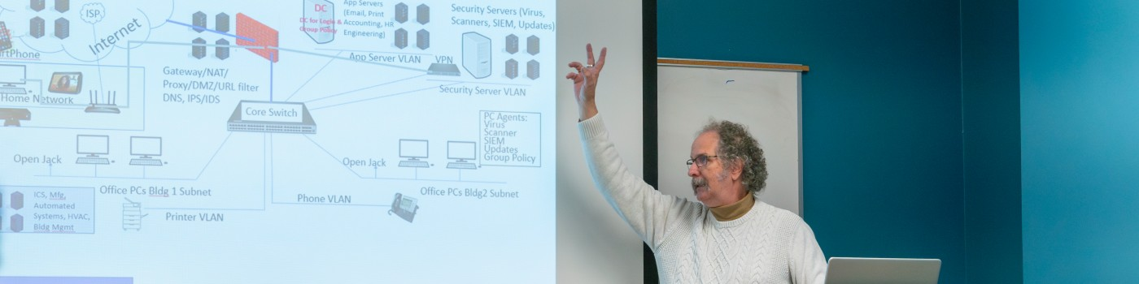
Cyber Encryption. A Hands-on Experience
Download slides at
Bhudsoncissp.com
Presented by Barry Hudson, bSides CHS November 2026
bhudsoncissp@gmail.com
GCFIV IRGVCTXMSR E LERHW-SR IBTIVMIRGI
CipherFidget lessons
At cipherfidget.com
TVIWIRXIH FC FEVVC LYHWSR

Slide 2
What is Cyber Encryption
Who, What, When Where, Why, and How
Encryption is the process of converting readable data into an unreadable format to prevent unauthorized access.
Plaintext to Ciphertext: Encryption takes original, readable information (plaintext) and uses a mathematical algorithm to scramble it into an unreadable format known as ciphertext.
Ciphertext to Plaintext: Decryption takes unreadable format and restores it to the original, readable information (plaintext).
The Role of the Key: The key, coupled with knowledge of the algorithm, enables you to run the process in reverse to decrypt.
Without the correct key, the ciphertext remains a meaningless jumble of characters to anyone who intercepts it.
The key must be protected.

Slide 3
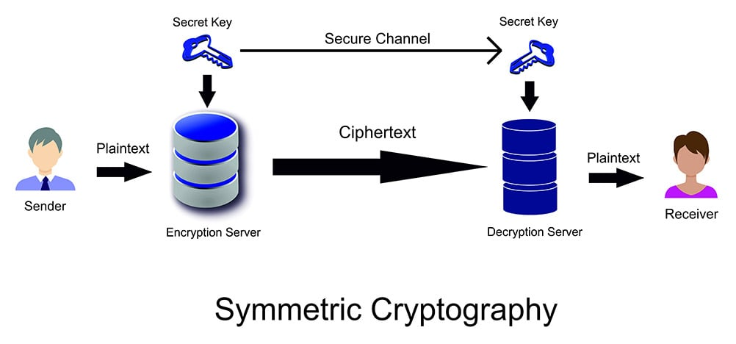

Who uses and How Encryption Works
Who, What, When Where, Why, and How
Sender and Recipient
(Role can be reversed with the same key)
Agree on an Encryption Key (and its transmission)
Using the key & algorithm:
Plaintext to Ciphertext by sender
Restored to Plaintext by recipient
Subject to Adversarial Attack
(If Bad Actor gains some control, they can alter, delete, or redirect the message.)
3057254
3057254
Out-of-band
LJRSW
HELLO
HELLO
Bad Actor
Man in the Middle
The Key is the sole secret, and must be kept secret.
The biggest problem is getting the keys to the recipient (key exchange)

Slide 4
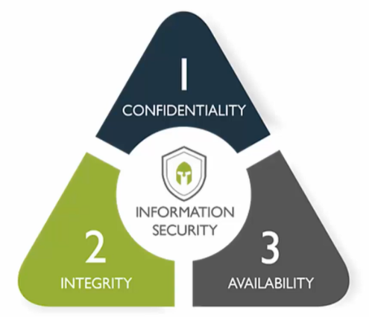
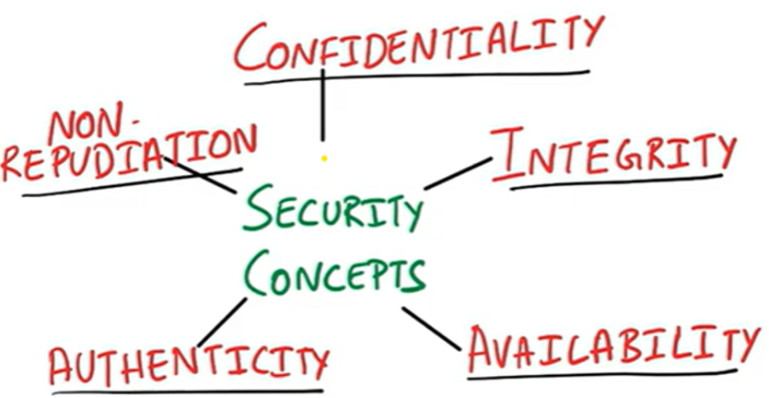
Why and When is Encryption Useful
Who, What, When Where, Why, and How
Extending the CIA Triad
Confidentiality (no snooping or interception)
Integrity of Data (no alteration to data)
Availability (not stolen or diverted)
Authenticity (genuine and verifiable)
Non-repudiation
(verification of sender)
Privacy Is Assured by combining these concepts
(averting adversaries)

Slide 5
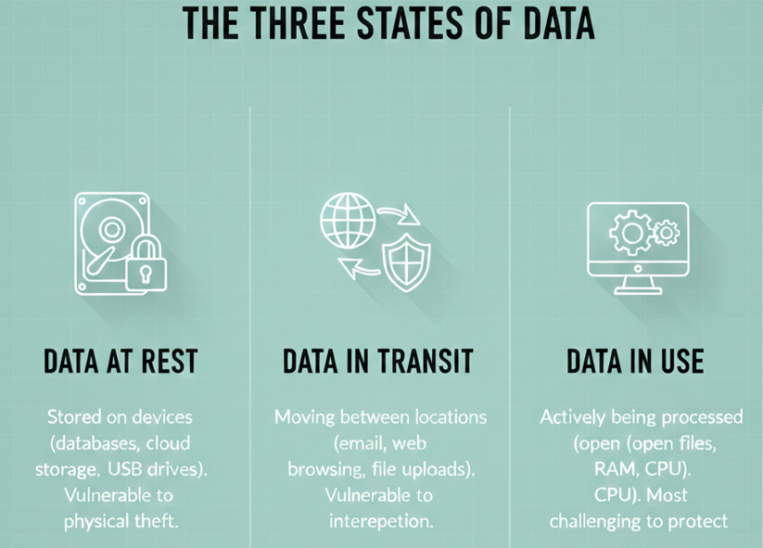
Where is Encryption Used
Who, What, When Where, Why, and How
Data at rest (on your PC, server, phone)
Vulnerable to physical theft or ransomware
Data In transit (email, text, Web activity)
Vulnerable to “man-in-the-middle
Data in use (being processed)
Vulnerable to Virus and malware that intercepts and sends to collection points

Slide 6
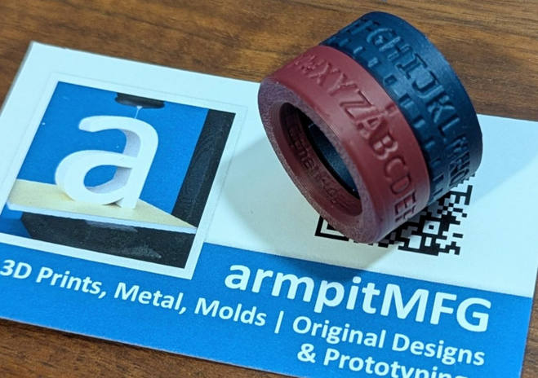
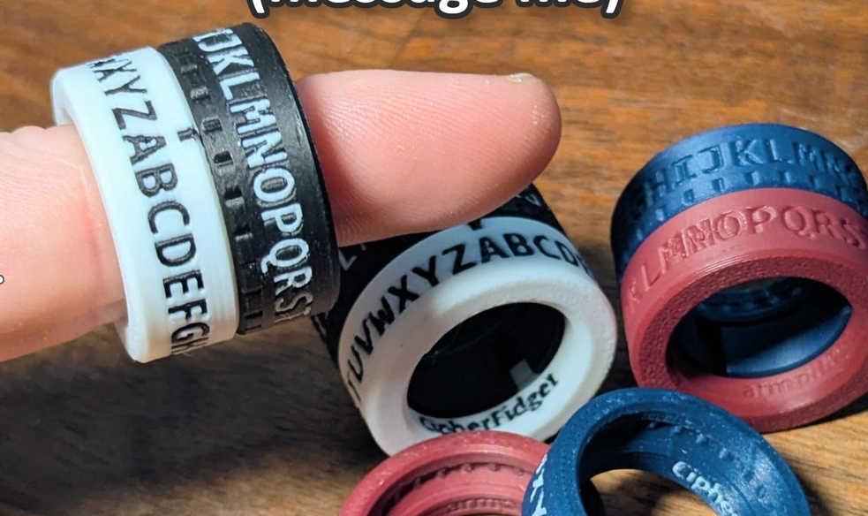
Introducing the CipherFidget
A tactile “secret decoder ring” paired with interactive lessons.
Contains 2 alphabetic rings that can be rotated independently.
Concepts apply to Roman secrets and modern digital encryption.
https://cipherfidget.com/
Lessons are available on the website

Slide 7
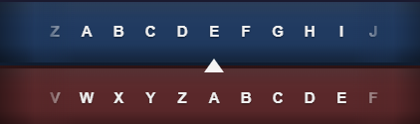
CipherFidget Lesson 1 The Basic Substitution Cipher
(monoalphabetic symmetric encryption)
Alphabetic Offset (ROTation) to encrypt HELLO
Click lower alphabet “4” positions to the right (bottom A= top E) and read the letters above H E L L & O __ __ __ __ __
https://cipherfidget.com/lessons/rot-x
See the Movie
https://www.youtube.com/watch?v=G8svL3REX9o

Slide 8
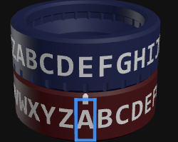
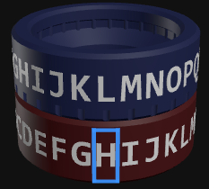
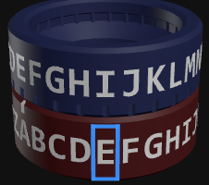
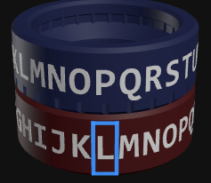
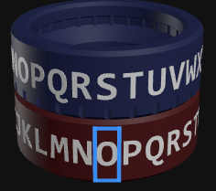
CipherFidget Lesson 1 Decryption & Discussion
Aside:
Pattern/Known plain text attack.
Can you crack this in 2 guesses?
M EQ E QER
Check that the the lower alphabet is“4” positions to the right and read (from the top row) the letters below L I P P & S
Notice anything about the encrypted message (LIPPS)?
Besides the double letter, what is the weakness?
  How many combinations are there for the key? (26)

Slide 9
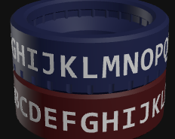
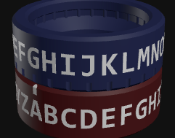
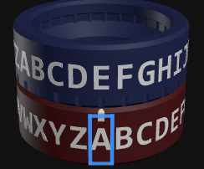
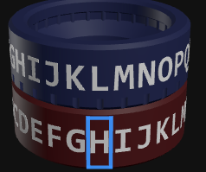
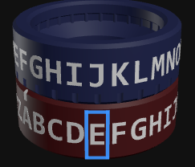
CipherFidget Lesson 2
ROT-X+: Rotating + Shift
https://cipherfidget.com/lessons/rot-x-plus
We will use an initial ROTx and add 1 click (or more) between letters to avoid the same result for the “LL”
Rotate 1 click before next letter
Rotate 1 click before next letter

Slide 10
CipherFidget Lesson 2 Discussion
https://www.dcode.fr/caesar-cipher
I AM A MAN
ROTx
M EQ E QER
ROTx+
M FS H UJX
ROT-X+: Rotating + Shift
(2 keys: the initial setting and the increment)
HELLO was LIPPS: becomes LJRSW with ROT4+1
What if we did +1, +2, +3, +1, etc? LJSVZ
Is this stronger from the second key, or because of more complex algorithm?
  If an adversary knew the algorithm (ROTX+) but not the keys, could they crack it faster than if they knew the keys but not the algorithm?
The takeaway: Adding more keys (like the increment) is valuable because it increases the "key space" — the number of possibilities an attacker must try.
The algorithm complexity helps too (it defeats pattern analysis), but never rely on keeping the algorithm secret!
Practice: Decrypt this using Rot6 +2 NIZBWDWMO

Slide 11
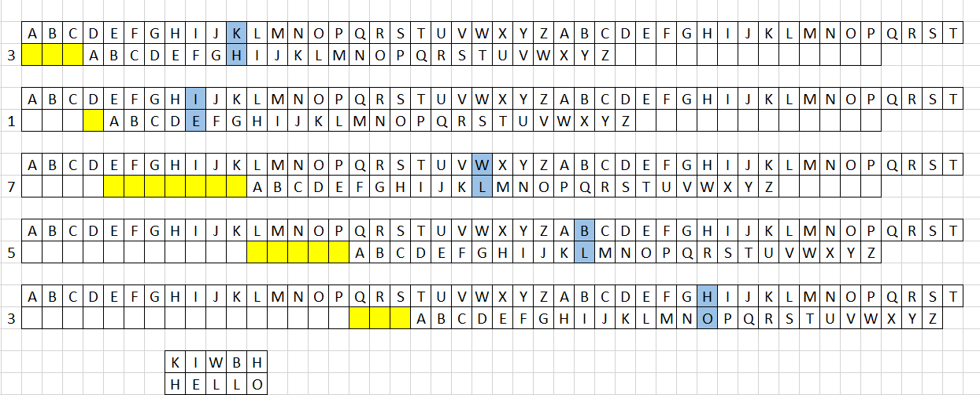
CipherFidget Lesson 2a
Key-Based Offsets… Do a different ROT before every letter….. Key=3 1 7 5
A=A, ROT3
ROT1
ROT7
ROT5
ROT3
Solves the Double-Letter Problem. We can change the Key Every Day. (but transmit it out-of-band)
Adversary has to guess key to crack the code. This has 10,000 possibilities. Longer keys increase complexity.

Slide 12
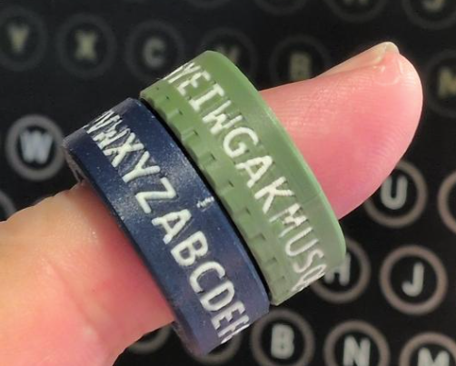
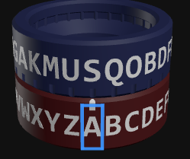
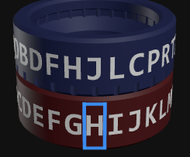
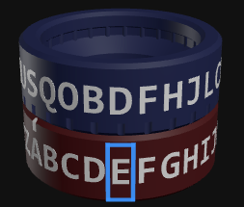
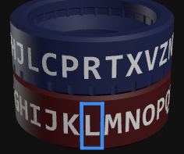
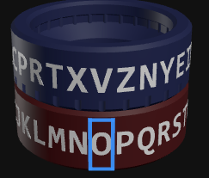
CipherFidget Lesson 3
Randomized Alphabet Top Ring
https://cipherfidget.com/lessons/randomized-alphabet
We will replace the upper ring with an Olive randomized alphabet (and use an offset of 4).

Slide 13
CipherFidget Lesson 3 Discussion
Randomized Alphabet Top Ring (Set to ROT4)
I AM A MAN
L ST S TSX
HELLO became JDRRV. Oh! L=R, so does that mean K is Q? (no)
  Double letter has returned
  Can we combine ROTx+ or Key-based offset with randomized ring (yes)
How much more powerful is the random ring alone?
  With a randomized alphabet, there are 26! (26 factorial) = 403,291,461,126,605,635,584,000,000 possible alphabet arrangements!
  403 million billion
Practice: Decrypt this using Rot3 QKSBN

Slide 14
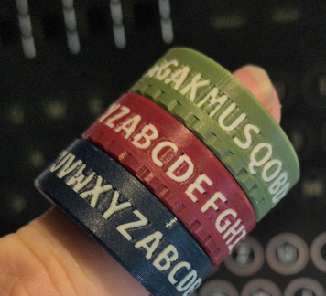
Want to Get More Complicated?
Are three rings better than two?
Replace the alphabetic ring as ring 2 (A’s aligned)
Add randomized ring as the top ring (A’s aligned)
Perform a ROT4 on the bottom ring
And let’s alternate between the rings
Fasten your seat belts…..

Slide 15
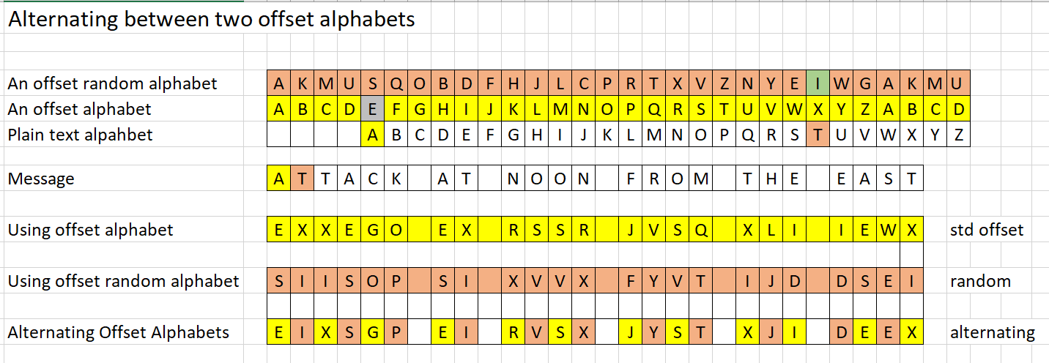
CipherFidget Lesson 3A Using 3 Rings
(polyalphabetic)
Using each ring by itself suffers from double letter syndrome (monoalphabetic)
  That is solved here without using ROTx+
Now the adversary has to identify a new algorithm And a new alphabet. (polyalphabetic)
Could we make it harder by doing a ROTx+? Using 2 different random alphabets?

Slide 16
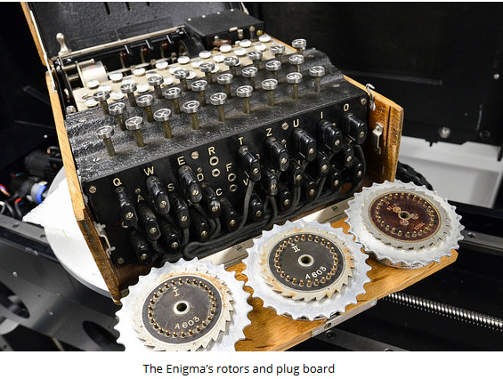
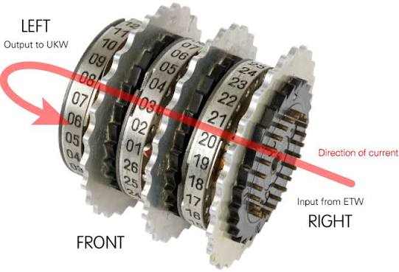
The Enigma used linked randomized rings for German encryption in WWII
https://www.101computing.net/enigma-machine-emulator/
https://www.101computing.net/enigma-machine-emulator/
https://enigma.virtualcolossus.co.uk/simulation.html

Slide 17
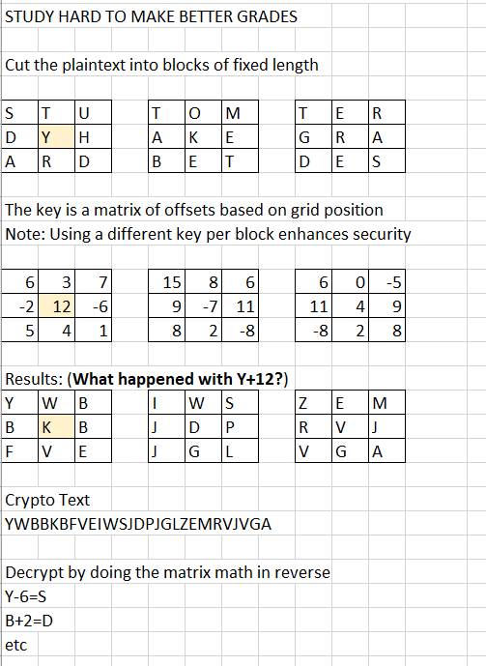
A Different Key Structure: Block Encryption and Transposition
The prior exercises encrypted a stream of characters using Substitution
We will take a different approach here: Transposition PLUS random keys
Key

Slide 18
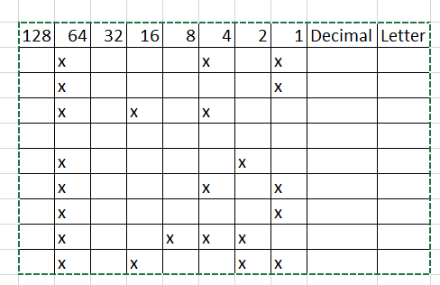
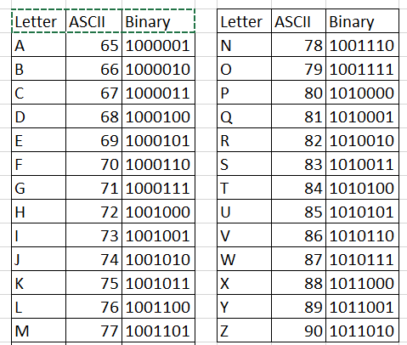
A Look Under the Hood: Binary Representation
We have been using the alphabet to demonstrate the concepts, but computers user Binary representation for letters and numbers
Let’s do a quick review of how binary and decimal are related
  (1’s, 10’s, 100’s, 1000’s vs 1’s, 2’, 4’s, 8’s)
What message is represented here?

Slide 19
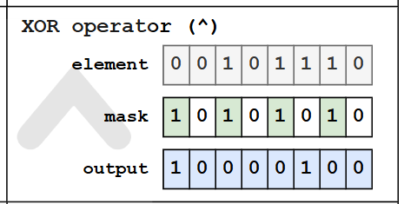

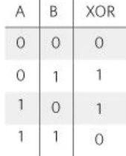
Binary Logic Operations are Core to Encryption
You’ve seen AND and OR. Here is a new one
XOR (Exclusive OR) is a logical, binary, and bitwise operation that returns “True”or “False”
  0 and 1 (in any order) is 1 (output is “True”)
  1 and 1 is zero, and 0 and 0 is 0. (Both inputs are the same the output is “False”)
Data Byte
Binary Mask
Output byte

Slide 20
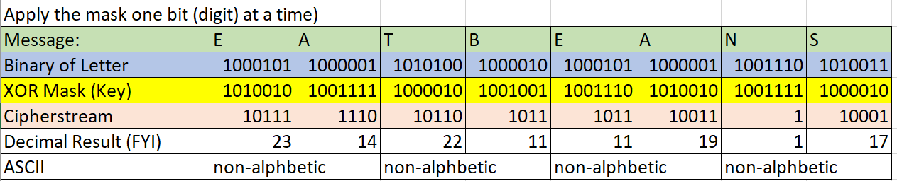
Applying XOR to Binary Encryption
We create a key (and exchange via secure channel) that has a binary representation
Similar to 3 1 7 5 in the earlier slide
To encrypt, we XOR the key to the binary (bits) of the plaintext
Note: The binary will not always represent readable letters.

Slide 21
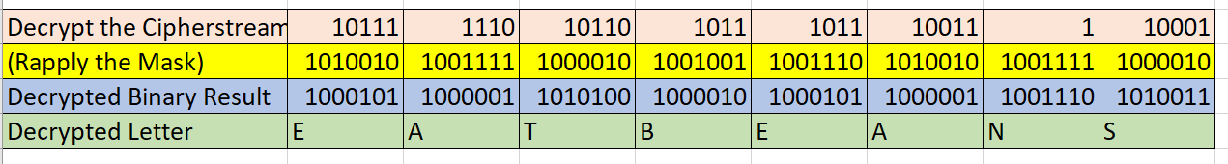
Applying XOR to Binary Decryption
Recall: To Encrypt, we XOR the key to the binary (bits) of the plaintext
To Decrypt, we XOR the key to the binary (bits) of the cyphertext

Slide 22
The (unique) Key is the sole secret, and must be kept secret.
Keys must be exchanged via secure channels
Key management is the downfall of symmetric key encryption.
If I work with 10 people and want to assure confidentiality with all 10, how many keys do we all have to manage?
What if I have 1000 employees plus 150 business partners, 15 banks?
  10 ->45 100->4950 1000-> 50 million (It is she sum of numbers from 1 to X-1)
And what if my company policy requires that keys be changed every year? Will I be able to open last year’s emails with this year’s keys?
Is there a better way? YES! It is called public key infrastructure (PKI) or asymmetric keys.

Slide 23
Public-Key Encryption (PKI*) Concepts
Public Key Infrastructure involves the creation, management, integrity, and distribution of encryption keys.
This concept and technology is often the most confusing, but holds the most promise for simplification of key management in large enterprises.
Remember the mantra for symmetric encryption:
  The (unique) Key is the sole secret, and must be kept secret
  But the problem is, in a workgroup of 100 people, about 5000 symmetric keys have to be exchanged.
Well now we are going to assign a pair of keys to everyone and post one them publicly for everyone to see.
  One key is used for encryption and the other is used for decryption.
* PKI means Public Key Infrastructure

Slide 24
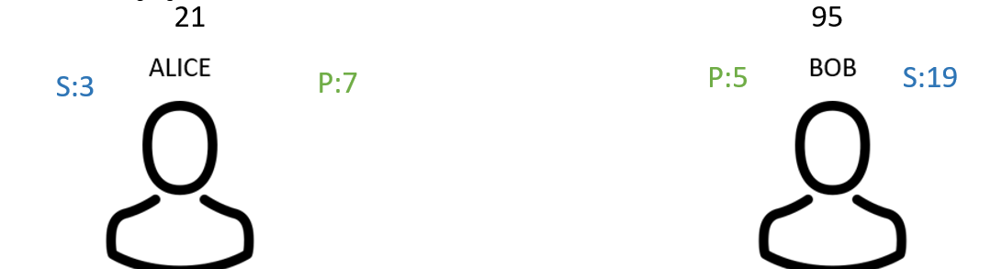
Creating Public-Key Encryption (PKI) Keys
(Asymmetric encryption.. approximate example)
Well now we are going to generate a pair of keys (that are mathematically linked). For example, 3x7=21 5x19=95 (in reality, VERY large prime numbers)
Everyone gets their own pair (and only needs 1 pair).
  One key is used for encryption and the other is used for decryption
  They are created using prime factors of very large numbers
  The public key (P) (and its product) are stored in a central server.
  Anyone can see the public key, but only the key owner can see the private key (S)
  Nobody can see the product
So which key do you think Alice would use to encrypt a message to Bob?

Slide 25
More About PKI Keys
Real PKI Keys use very large prime numbers (2048 bits = 600+ decimal digits)
5 x 19 =95 was a simple case. If you know Bob’s public key of 5, you can guess some of its multiples against primes and get to 95 quickly. (5x3, 5x7, 5x11, 5x13, 5x17, 5x19=95)
Here is a pair of large five-digit prime numbers and their resulting product:
  Prime 1: 88,897
  Prime 2: 77,773
  Product: 6,913,786,381
If 88,897 is my public key, what are the chances you could derive my private key?
While a computer can multiply these two numbers instantly, it is incredibly difficult for a computer to do the reverse—taking the product 6,913,786,381 and "factoring" it back into 88,897 and 77,773

Slide 26
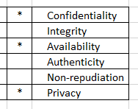
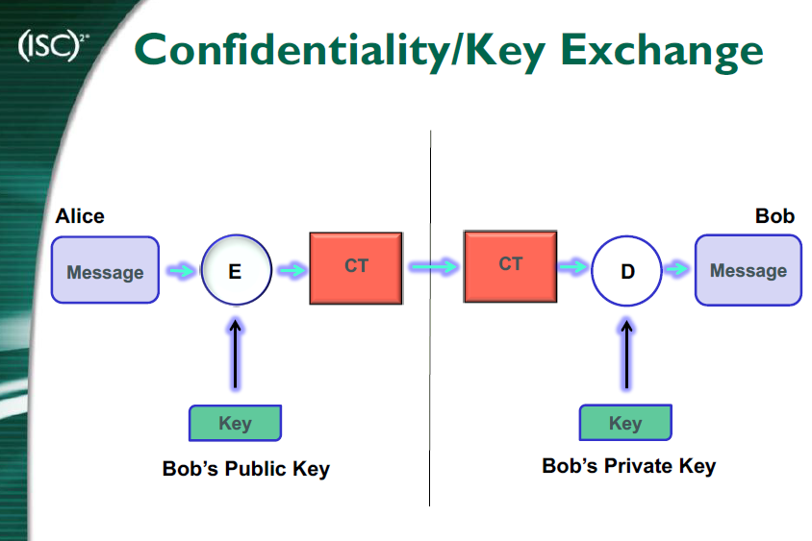
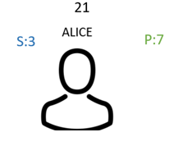
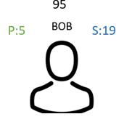
Using PKI to Send an Encrypted Message
Confidentiality
Alice Uses Bob’s public key (5) to encrypt a message to him
Bob uses his private (secret) key (19) to decrypt the message
Bob does the reverse to send a secure reply
Confidentiality with Encryption
Bad Actor
Man in the Middle
5
19
Note: The man-in-the middle can possibly intercept the ciphertext, but would need to guess the Bob’s private key to decrypt. Knowing Bob’s public key only enables someone to encrypt, not decrypt. But maybe he can replace the cyphertext.

Slide 27
What Happens if the Man-In-The-Middle is Successful?
Encryption can (almost) provide confidentiality, but could fail
  They can intercept the encrypted message
  They can decrypt the message and know your confidential information
  They can create a modified message, encrypt it, and send it to the recipient
How can we detect if the message was modified
What if there was a way to create a fingerprint of the message and compare it upon receipt?
See hashes (If we have time)

Slide 28
Welcome to Hashes (Bonus material)
What is a Hash?
  A hash function is a function that takes as input an arbitrarily long string of bits (or bytes) and produces a fixed-size result
  The result is a Hash. It is basically a number.
A hash comparison is used to assure a file has not been altered.
Let's invent a simple hash for this slide by choosing the first letter of each line. Would it be a good tool to see if there are any changes? WAbTALWRsMbMe
Real hashes look like this: The results are completely different for even a slight change in the text or document
  My dog has fleas that it got from the cat. b4f5dc1dc963f40b24c4eeabf3da715f
  My dog has Fleas that it got from the cat. e18e88b66a82a7f5bf95d7681706ee3b
Aside: How are hashes used with password storage?

Slide 29
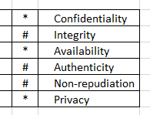
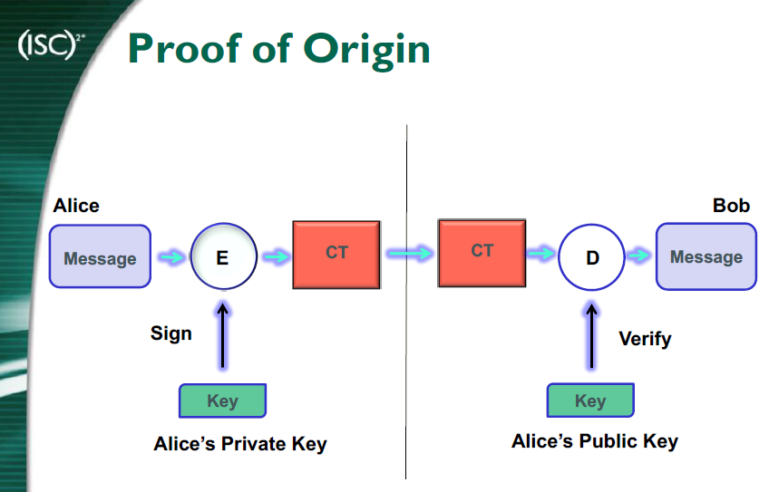
Using PKI and Hashes to Verify Message Integrity and Sender Verification (Bonus)
Integrity
Alice creates a Hash of the message in the previous slide.
Alice uses her Private key (3) to encrypt the Hash and then sends it to Bob. (This is the signature)
Bob uses his Alices public key (7) to decrypt the Hash. (it is just a string)
If the decrypt is successful, that verifies Alice was the sender. (Non-repudiation)
Bob creates a Hash from the message he received in the prior slide, and compares to this one Alice sent.
If the Hashes match, then there was no alteration. (Integrity)
Proof of Origin and No Alteration
Digital Signature
hash
hash
Do the hashes Match?
Bad Actor
Man in the Middle
3
7
Note: The hash need not be encrypted, but doing so adds the value of verifying that Alice sent it. It also assures the has was not maliciously altered to match a possible man-in-the-middle attack.

Slide 30

Asymmetric Key Use in 20 Words or Less
Encryption
Digital Signature
Send a message*
Was he able to decrypt the hash? If so, it could have only come from Alice
Create, encrypt, and send the hash of the message
Decrypt the hash
Re-Create the hash of the message
hash
hash
Do the hashes Match?
If yes, integrity is true.
hash
hash
*Note: It can be the encrypted message
Let’s look a C, I, and A
Why does Alice encrypt her Hash instead of her Message with her private key?
Could she encrypt her message (with Bobs public key) and then hash the encrypted message and then encrypt that hash with her public key?

Slide 31
Cyber Encryption. A Hands-on Experience
Download slides at
Bhudsoncissp.com
Presented by Barry Hudson, bSides CHS November 2026
bhudsoncissp@gmail.com
GCFIV IRGVCTXMSR E LERHW-SR IBTIVMIRGI
CipherFidget lessons
At cipherfidget.com
TVIWIRXIH FC FEVVC LYHWSR

Slide 32
Other CipherFidget Lessons (Codebreaking)
SKIP?
Known Plaintext Attack
  Guessing likely words or phrases, or easy words like “I”, “IN”, “ON”, or “A” to solve part of the ciphertext, resulting in a quick crack.
  Maybe you know the sender always starts letters with "DEAR" or ends with "SINCERELY." This partial knowledge is called a crib, and it can break even complex ciphers!
T LX RZTYR ZY L ECTA TY L MZLE

Slide 33
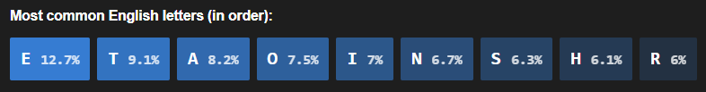
Other CipherFidget Lessons (Codebreaking)
SKIP?
Frequency Analysis Attack
  In English text, some letters appear much more frequently than others. The letter E appears about 12.7% of the time, while Z appears less than 0.1%.
  In earlier lessons, we mentioned that simple substitution ciphers have a weakness: repeated letters in the plaintext produce repeated letters in the ciphertext. But how exactly do attackers exploit this?
  The answer is frequency analysis — a technique that has been used for over a thousand years to break substitution ciphers. It was first described by the Arab mathematician Al-Kindi in the 9th century!
  For Caesar ciphers specifically: once you guess one letter, you know the shift!

Slide 34
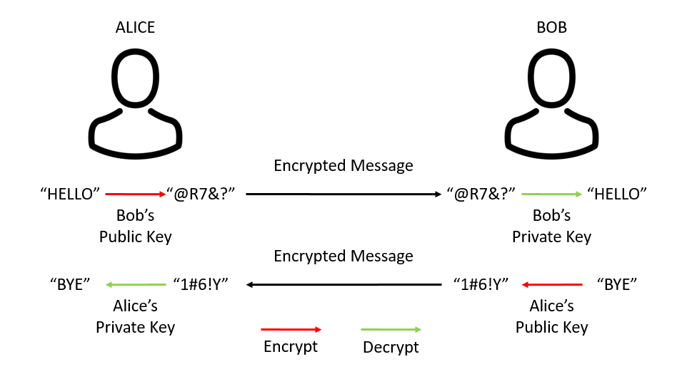
Public-Key Encryption (PKI) Process
SKIP?
21
95
So which key do you think is used for encryption? Public. Listen carefully..
  When Alice wants to send a message to Bob, she first obtains Bob’s public key.
  Alice encrypts the message m with the public key P(Bob) to get the ciphertext c, and sends c to Bob.
  Bob uses his secret key S(Bob) and the decryption algorithm to decrypt the message and get the message m.
  The process is reversed when Bob replies to Alice.
S:3
P:7
P:5
S:19
Barry sez: Email is used for illustration only. The same thing can be done under program control for server-to- server, between applications, and web sessions and more.

Slide 35
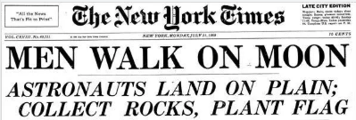

Some Ideas for Key Exchange
SKIP?
Via telephone (but not email or text)
A codebook with a new key for every day of the year
A formula to compute a new key based on the high temperature the day before*
The first letter of words in today’s headlines ( MWOMALOPCRPF)
Hidden in plain sight (ROBIN)
*Key = 48 (temperature) / 7 (date) truncated to 6 decimal places
6.857142
Aside. If you have 9 friends and want to exchange secrets with all of them independently, how many keys do you need? How do you manage them?

Slide 36
Other CipherFidget Lessons (Codebreaking)
SKIP?
Known Plaintext Attack
  Guessing likely words or phrases, or easy words like “I”, “IN”, “ON”, or “A” to solve part of the ciphertext, resulting in a quick crack.
  Maybe you know the sender always starts letters with "DEAR" or ends with "SINCERELY." This partial knowledge is called a crib, and it can break even complex ciphers!
T LX RZTYR ZY L ECTA TY L MZLE
I AM GOING ON A TRIP IN A BOAT

